Slide 1

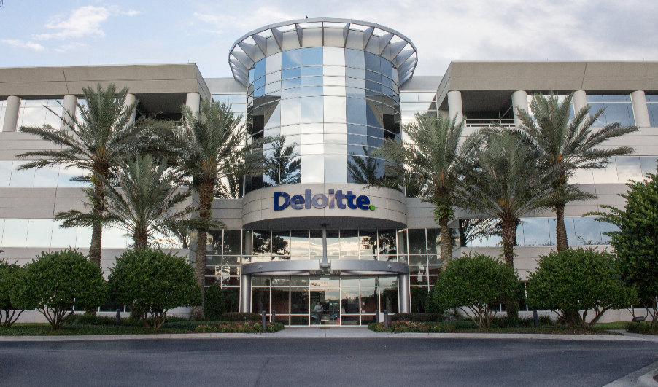
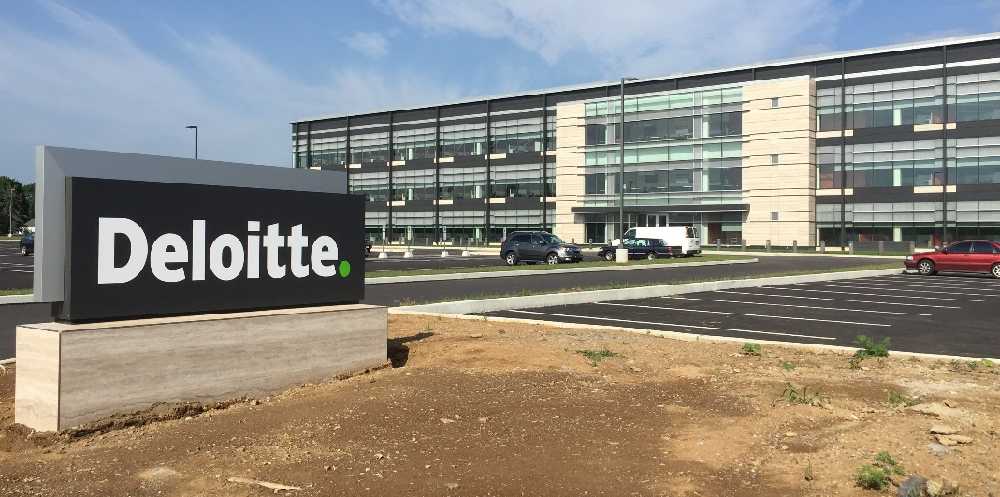
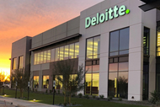
USDC Information Technology Center of Excellence (IT-CoE)
Topic: CompTIA Security+ Testing Review
Orlando, FL
Mechanicsburg, PA
Gilbert, AZ

Slide 2



USDC IT CoE: Security+ Testing Review – Session 6
Cryptography

Slide 3
Cryptography
Security+
Session 6
CompTIA Security+
Test: SYO-601
EXAM OBJECTIVES (DOMAINS)
The table below lists the domains measured by this examination and the extent to which they are represented:
Domain | Weight
1.0 Threats, Attacks and Vulnerabilities | 24%
2.0 Architecture and Design | 21%
3.0 Implementation | 25%
4.0 Operations and Incident Response | 16%
5.0 Governance, Risk, and Compliance | 14%
Total | 100%
Session 6
Includes Objectives from Domains 1, 2 and 3
Objective 1.2 – Given a scenario, analyze potential indicators to determine the type of attack.
Objective 2.1 – Explain the importance of security concepts in an enterprise environment.
Objective 2.8 – Summarize the basics of cryptographic concepts.
Objective 3.9 – Given a scenario, implement public key infrastructure.

Slide 4
Cryptography
Security+
Session 6
Terminology
Asymmetric Cipher – Cryptographic algorithms that use two different keys, one key to encrypt and another to decrypt. Also called public key cryptography.
Collision – When two different inputs into a cryptographic hash produce the same output.
Cryptographic Hash – A function that is one-way (nonreversible), has a fixed length output, and is collision resistant.
PRNG – Pseudo-random Number Generator – An algorithm used to generate a number that is sufficiently random for cryptographic purposes.
Rainbow table – A table of pre-computed hashes used to guess passwords by searching for the hash of a password.
Symmetric Cipher – Any cryptographic algorithm that uses the same key to encrypt and decrpypt, DES, AES, and Blowfish are examples.

Slide 5
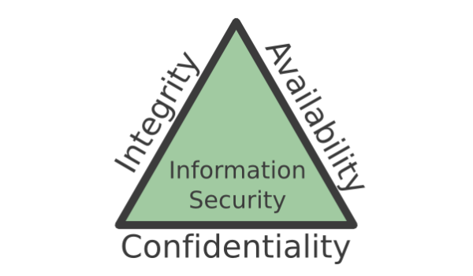
The Security Triad
The CIA Security Triad
A model to guide policies for information security within the entire organization.
Confidentiality is the set of rules that limits access to information to only those that are authorized to use the information. Security controls include user ids, passwords, ACLs, policy-based security, and encryption.
Integrity is the assurance that the information is trustworthy and accurate. Ensures that it is edited by only authorized persons and remains in its original state when at rest. Data encryption and hashing are processes to ensure integrity.
Availability is a guarantee of reliable access to the information by authorized individuals. Hardware maintenance, software patching/upgrading, and network optimization ensures availability.

Slide 6
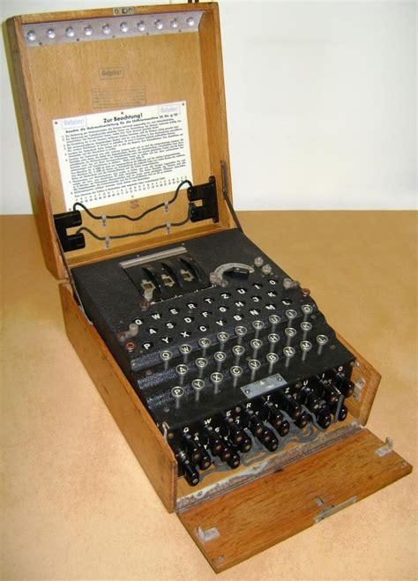
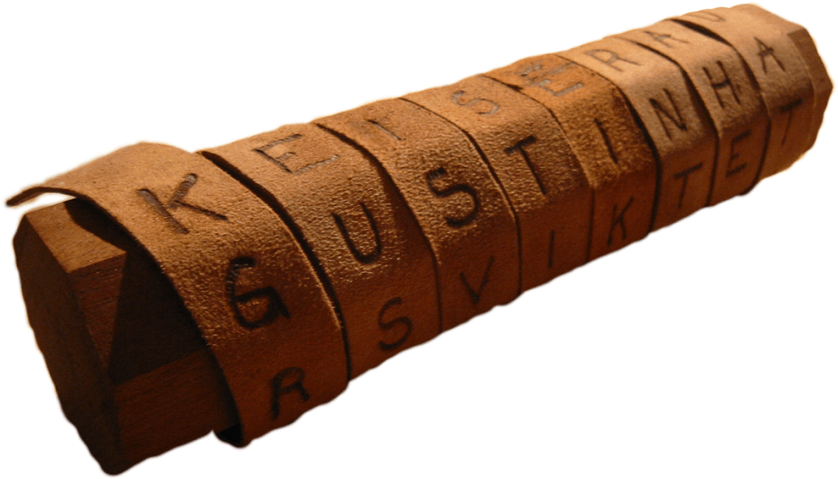
Cryptography
Security+
Session 6
History of Cryptography
The use of cryptography to conceal messages goes back over thousands of years to the Egyptians and the Greeks that used substitution cyphers.
The Greeks devised a cypher system where the message was written on a strip of leather but would only make sense if it was wrapped around a wooden stick of a certain diameter. This was a called a scytale.
People have devised lots of different ways of encrypting messages, from the Caesar cypher, (a shift cypher) to disappearing ink.
When complex machines were invented, they were used for creating cyphers. The Enigma Machine was created by the Germans in World War II. It generated encoded messages, but was broken by the British, so, they were able to read the secret war messages.

Slide 7

Cryptography
Security+
Session 6
Steganography
The process of hiding a message in a digital image, audio file or another file.
Changing least significant bits in the bit map of an image would not make any discernable changes in how the image is viewed but could containe a hidden message.
Messages can be hidden in audio files, video files or any other digital file.
There are free and available programs on the web for doing steganography.

Slide 8
Cryptography
Security+
Session 6
Modern Cryptography
Begins with the development of computer systems and the need to keep the data safe and secure.
Modern computerized cryptography really only began in the 1970’s with the development of the DES (Data Encryption Standard) by IBM.
Plaintext + Initialization Vector + Algorithm + Key = Ciphertext
Goals of Cryptography
Privacy (or confidentiality)
Authentication – proof that the message is from the person that we think
Integrity – Message has remained unaltered at the point it was produced, in transit, and during storage
Non-repudiation – Sender is provided with proof of delivery, and receiver is assured of sender’s identity.

Slide 9
Cryptography
Session 6
Security+
Types of Ciphers
Block Ciphers
Breaks the message into discrete blocks for encryption and decryption. 64-bit blocks are commonly used. Each block is encrypted using various encryption methods:
Substitution
Transposition
Confusion
Diffusion
Stream Ciphers
The message is a stream of bits such as a streaming video, voice conversation, or wireless access point.
Each bit is encrypted as it is sent in the stream and decrypted on the other end.
Encryption methods include a pseudorandom key and an exclusive OR operation (XOR).

Slide 10
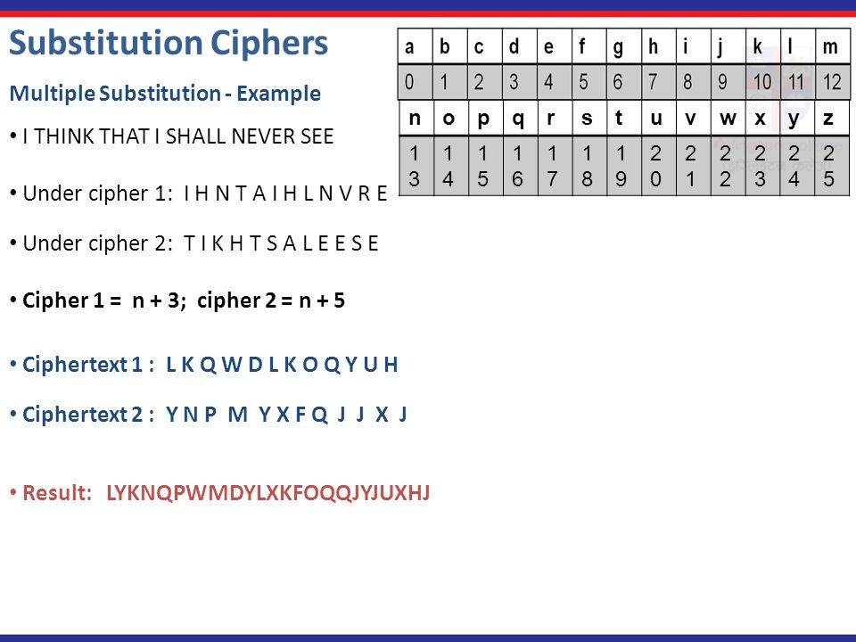
Cryptography
Security+
Session 6
Substitution Cipher
Method of generating cryptographic text where the original plain text characters are substituted with a different set of text characters.

Slide 11
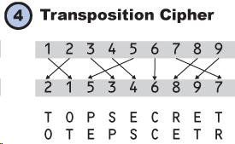
Cryptography
Security+
Session 6
Transposition Cipher
Method of generating cryptographic text where the original character positions are moved to different locations.

Slide 12
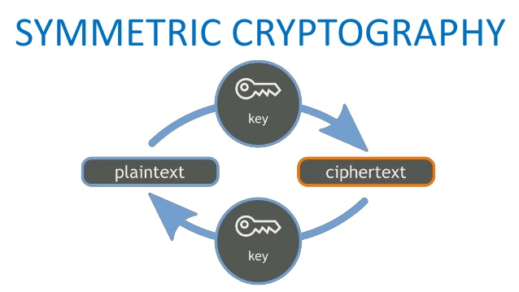
Cryptography
Security+
Session 6
Symmetric Cryptography
Developed in the early 1970’s by IBM and submitted to the NBS (National Bureau of Standards) as a means for securing government computer messages and data.
Symmetric Cryptographic algorithms use a single key to encrypt and decrypt message text.
It is a fast cryptographic method but presents some problems with key transfer between the two parties and maintaining the security of the key.

Slide 13
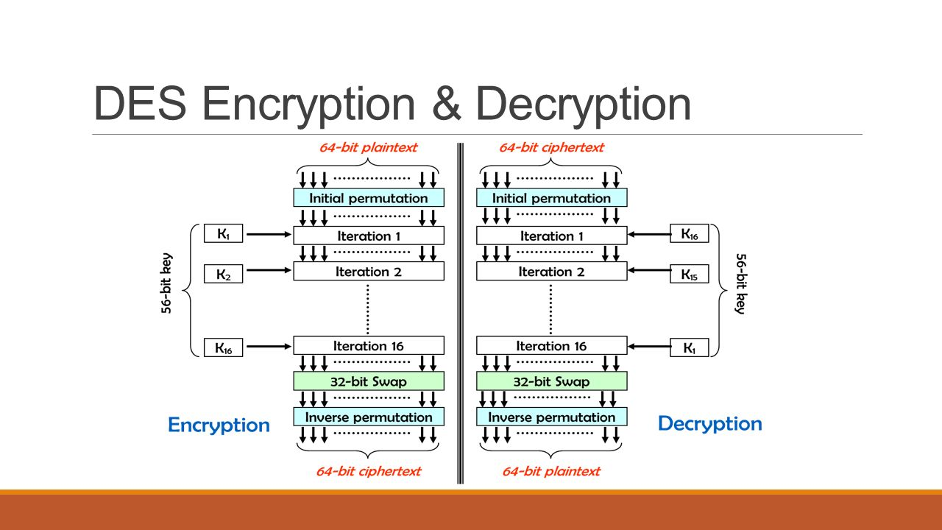
Cryptography
Security+
Session 6
DES – Data Encryption Standard
Developed by IBM and published in 1977, it was the standard for over 20 years, before it was broken and deemed insecure.
A Block Cipher the processes 64 bits of plain text at a time and outputs 64 bits of ciphertext. The DES key is a 56-bit key.
MODES OF OPERATION
ECB – ELECTRONIC CODEBOOK MODE
CBC – CIPHER BLOCK CHAINING MODE
OFB – OUTPUT FEEDBACK MODE
CFB – CIPHER FEEDBACK MODE

Slide 14
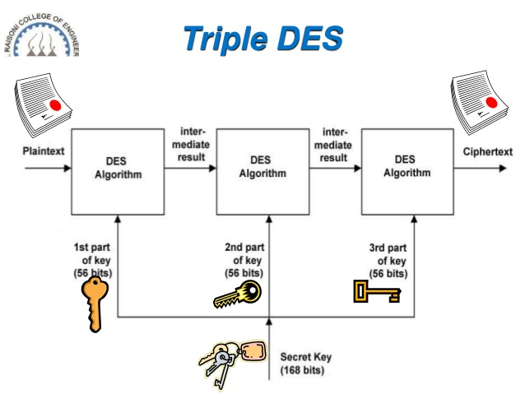
Cryptography
Security+
Session 6
Triple DES
Triple DES was developed after DES was determined to be insecure.
It applies a plaintext message through the DES algorithm three times with changes in the key in each step.
The total key size is 168 bits.
It is considered secure and is still in use today.

Slide 15
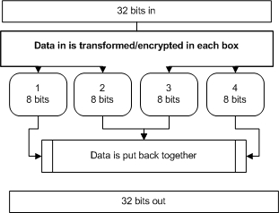
Cryptography
Security+
Session 6
Blowfish and Twofish
Blowfish was designed in 1993 by Bruce Schneider, as a symmetric encryption algorithm. The code is in the public domain and available to everyone.
Key size: 32-448 bits
Block size: 64 bits
Twofish was the successor to Blowfish.
Key size: up to 256 bits
Block size: 128 bits

Slide 16
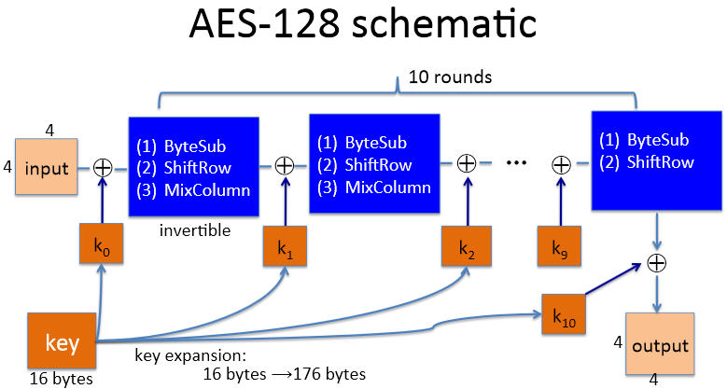
Cryptography
Security+
Session 6
AES (Advanced Encryption Standard)
In 1997 the NIST (National Institute for Standards and Technology) began a search for the DES replacement. A contest lasted 3 years and was open for any entry. The Rinjdael algorighm, from Vincent Rijmen and Joan Daemen, was selected for AES and is now the standard for Symmetric Encryption.
The algorithm uses three layers of transformation to encrypt and decrypt blocks of message text:
LINEAR MIX TRANSFORM
NONLINEAR TRANSFORM
KEY ADDITION TRANSFORM
Supports variable key and block lengths of 128, 192, and 256 bits.

Slide 17
Cryptography
Security+
Session 6
Stream Cipher
A symmetric key cipher, where plaintext bits are combined with a pseudorandom cipher stream of bits to create a bit-by-bit ciphertext stream.
Stream ciphers are used in secure wireless communications. Including secure mobile phone calls, streaming video, etc.
Fast encryption method.
RC4 was the original stream cipher, used in WEP and WPA for wireless access points. Now insecure.
RC5 is the successor to RC4 and is more secure.
Plaintext
Cipher Key
Cipher Text
RC4
XOR Function
1 0 1 0 1 1 0 0 0 1 1 1
1 0 0 0 1 1 1 1 0 0 0 0
0 0 1 0 0 0 1 1 0 1 1 1

Slide 18
Cryptography
Security+
Session 6
Knowledge Check 1
A company is planning to encrypt the files in several sensitive directories of a file server with a symmetric key.
Which of the following could be used?
A. RSA
B. TwoFish
C. Diffie-Helman
D. NTLMv2
E. RIPEMD

Slide 19
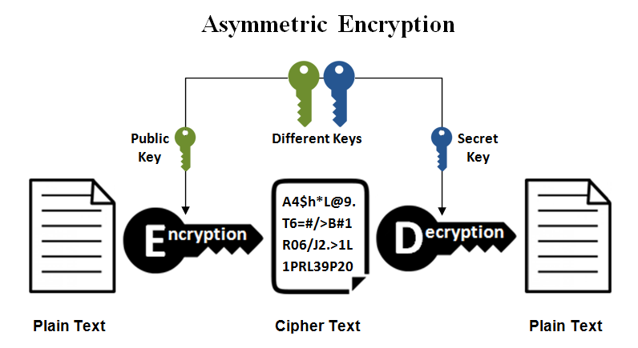
Cryptography
Security+
Session 6
Asymmetric Encryption
Two keys: public and private
Public key is uses to encrypt, private key is used to decrypt
Satisfies the security categories of:
Confidentiality
Integrity
Authentication
Non-repudiation
Public key is prime number, private key is large prime number
Encryption algorithm is strictly numeric, with converting the message text to numeric, and applying the public key numerically to produce a very large number which is the ciphertext.

Slide 20
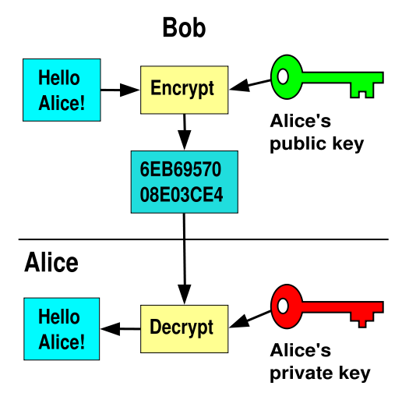
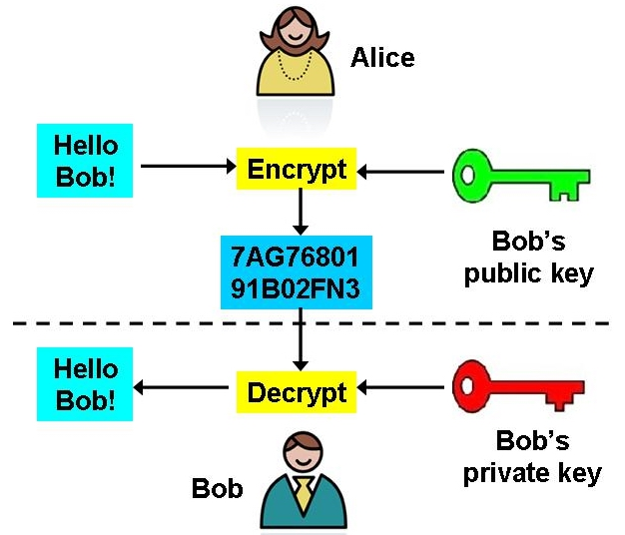
Cryptography
Security+
Session 6
Asymmetric Encryption

Slide 21
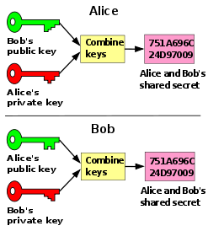
Cryptography
Security+
Session 6
Asymmetric Encryption
Diffie-Hellman Key Exchange – (DHE) developed for secure key exchange of a shared secret key across a public network.
This is the primary way in cryptography for exchanging keys over an insecure medium.
This method does not encrypt any messages, just creates a new shared key for each session.
This key can then be used in the symmetric encryption process.

Slide 22
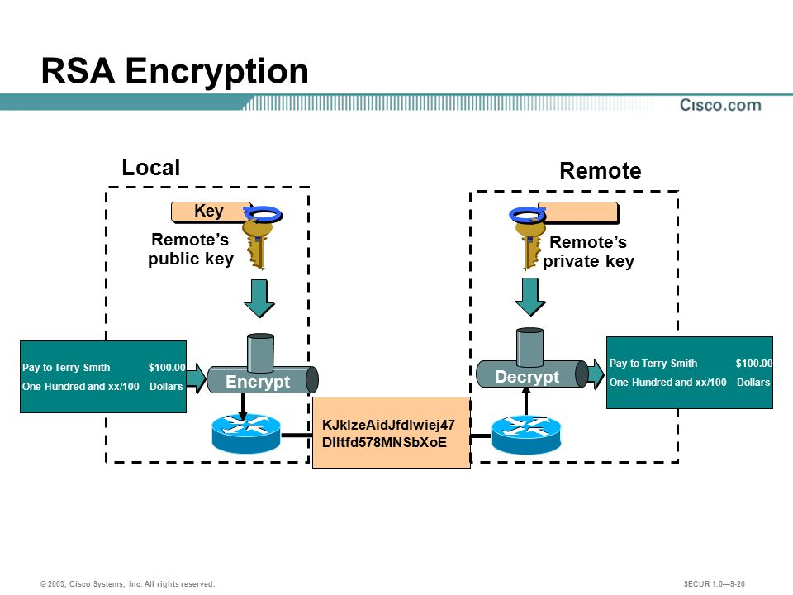
Cryptography
Security+
Session 6
Asymmetric Encryption
RSA (Rivest, Shamir, and Adleman) developed this asymmetric encryption algorithm in 1978.
Two keys: a public and a private key
Key size up to 3,072 bits
Discrete logarithm of prime numbers
Now the default standard for asymmetric encryption.

Slide 23
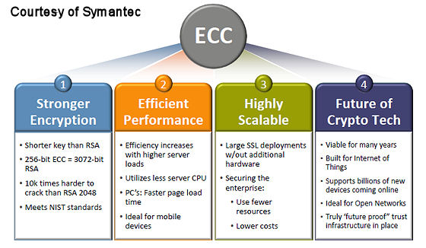
Cryptography
Security+
Session 6
Asymmetric Encryption
ECC - Elliptic Curve Cryptography provides similar functionality to the RSA algorithm but uses smaller keys to provide the same level of security.
For example: a 256-bit elliptic curve public key should provide comparable security to a 3072-bit RSA public key.
The NSA and NIST recommend the use of ECC for asymmetric crytopgraphic needs.

Slide 24
Cryptography
Security+
Session 6
Knowledge Check 2
An organization wants to conduct secure transactions of large data files. Before encrypting and exchanging the data files, the organization wants to ensure a secure exchange of keys.
Which of the following algorithms is appropriate for securing the key exchange?
A. DES
B. Blowfish
C. DSA
D. Diffie-Hellman
E. 3DES

Slide 25
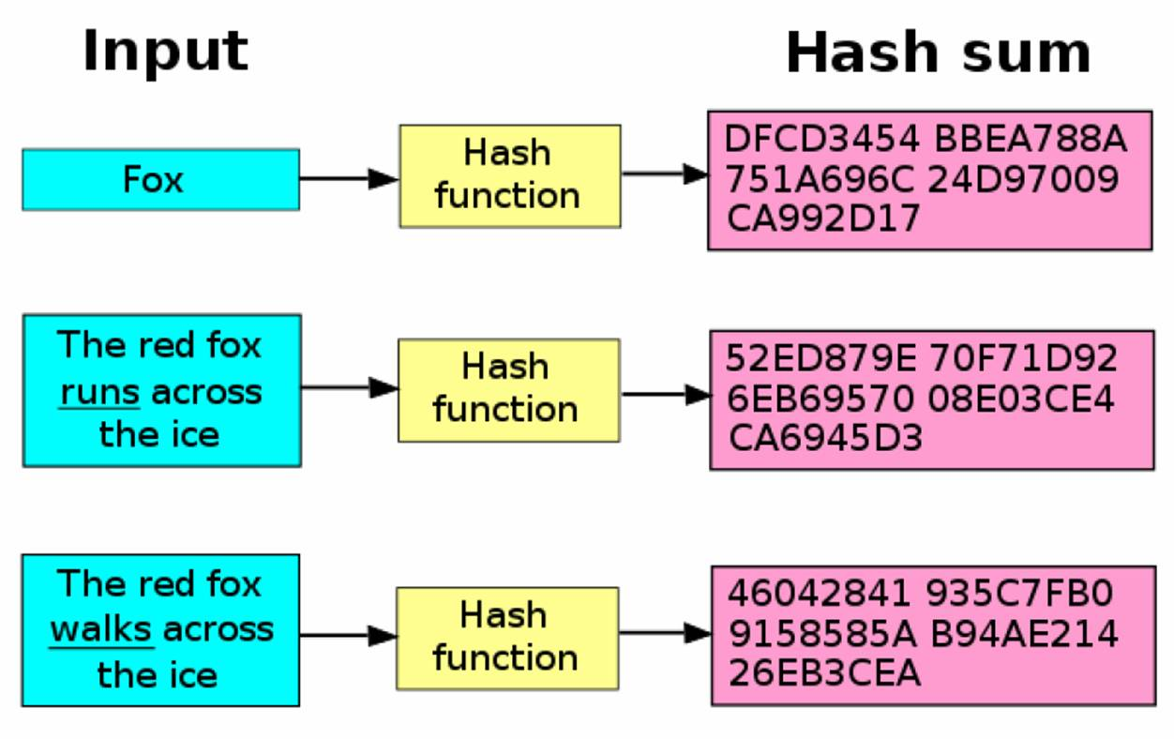
Cryptography
Security+
Session 6
Hashing
A cryptographic function that generates a one-way, irreversible representation of any file, document, or plaintext.
Any change in the text will produce a totally different hash value.
Hashes can be used for digital signatures, message authentication codes, and to verify message integrity and authentication.

Slide 26
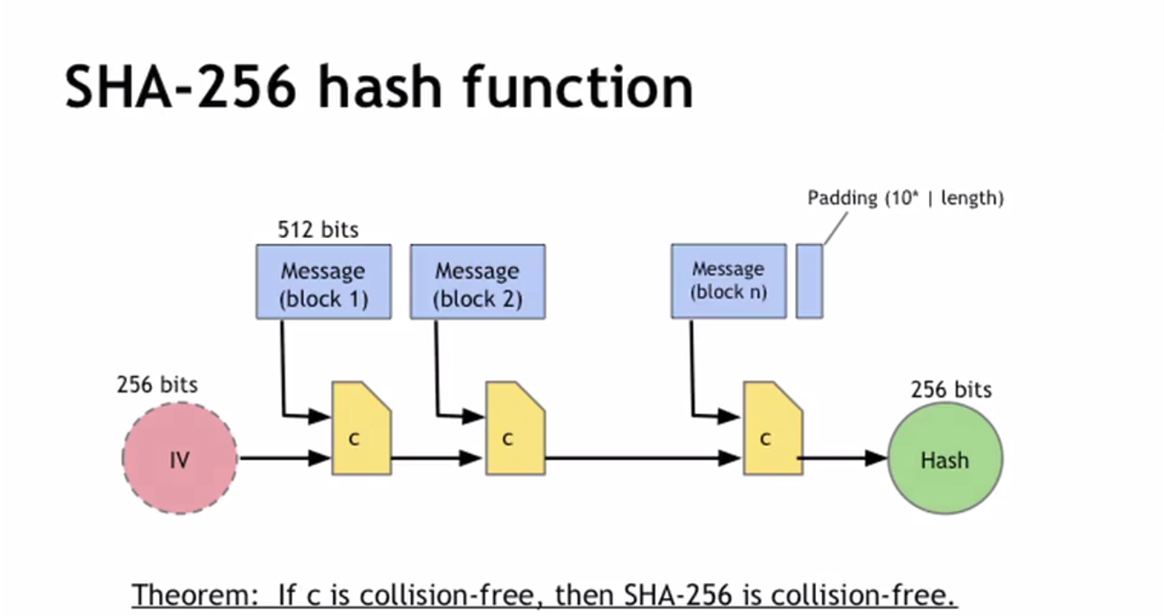
Cryptography
Security+
Session 6
Hashing
MD5 (Message Digest 5) is a hashing function that produces a 128-bit hash value.
Developed by Ron Rivest in 1992 as a replacement of the previous MD4, which was found to be vulnerable.
MD5 has been proven vulnerable to collisions.
SHA (Secure Hash Algorithm) is a hashing function that produces a 160-bit hash value, rendered as a hexadecimal value 40 bytes long.
SHA was developed by the NSA (National Security Agency) and is considered the most secure hashing function available.

Slide 27
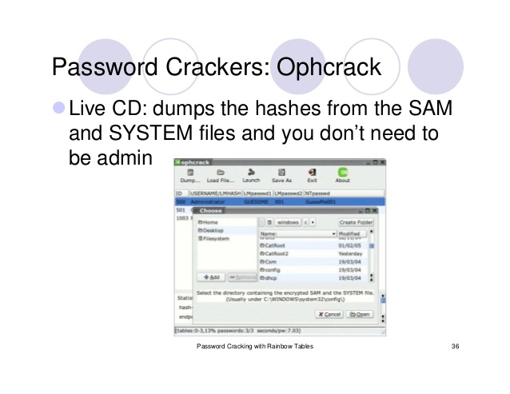
Cryptography
Security+
Session 6
Hashing
Rainbow Table is a database table of all of the possible hashes computed in advance. Based on plaintext lengths of 4, 5, 7 letter, etc. for an original plaintext.
Searching the table would give a match for a password hash value.
Tools like OphCrack use rainbow tables to crack a password.
Salting is a countermeasure to rainbow tables. This is adding random bits to the beginning or end of a hash to make the hash variable and defeat the rainbow table attack.
Hashed passwords are kept in the SAM (Security Account Manager) file in a Windows operating system.

Slide 28
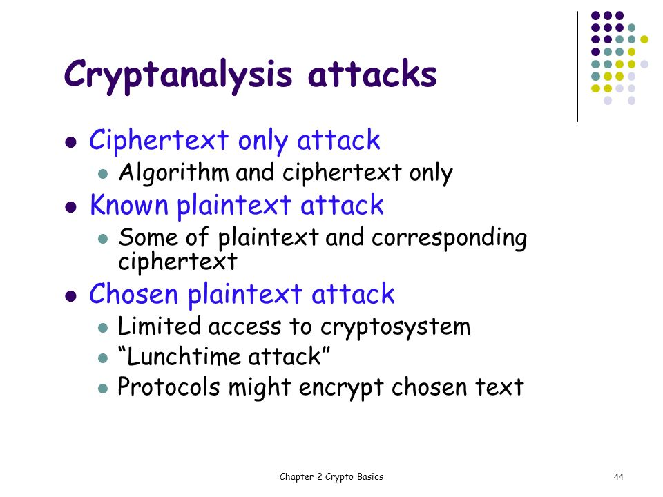
Cryptography
Security+
Session 6
Cryptanalysis
Brute Force – Trying all possible keys for a cipher to find the right key.
Frequency Analysis – Examining the encrypted message to try to find frequently used letters or words to decrypt those common words like:
the, and, it, is
Known Plain Text – Having access to the original text and the ciphertext to begin the process of comparing and breaking down the ciphertext.
Chosen Plain Text – Having access to ciphertexts of chosen plaintexts to process.

Slide 29
Cryptography
Security+
Session 6
Knowledge Check 3
Which of the following is used to validate the integrity of data?
A. CBC
B. Blowfish
C. MD5
D. RSA

Slide 30
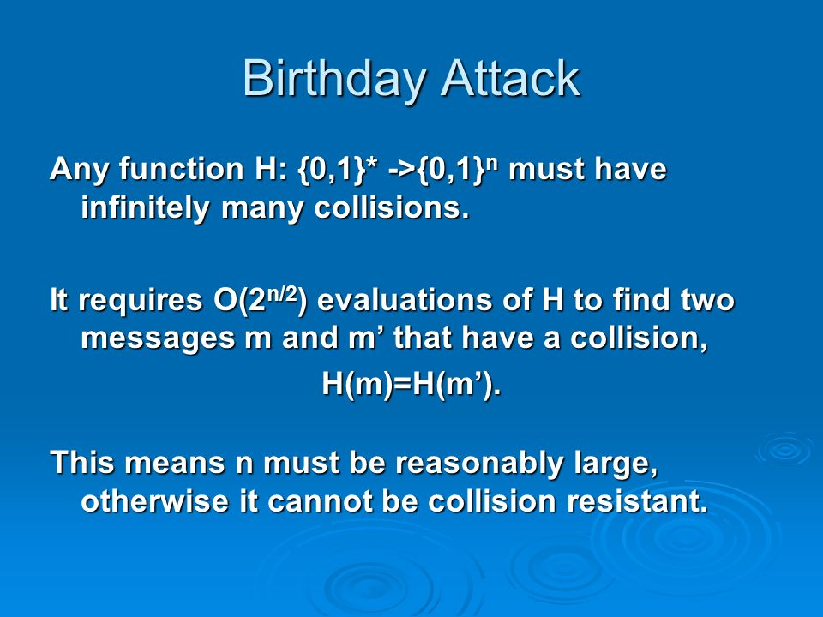
Cryptography
Security+
Session 6
Cryptanalysis
Birthday Attack – Trying to break a hashed value by replicating a collision of hashed values based on the birthday theory that within a set group of people, some will have the same birthday.
Dictionary Attack – To determine a password, then words from a dictionary are tried and tested.
.

Slide 31
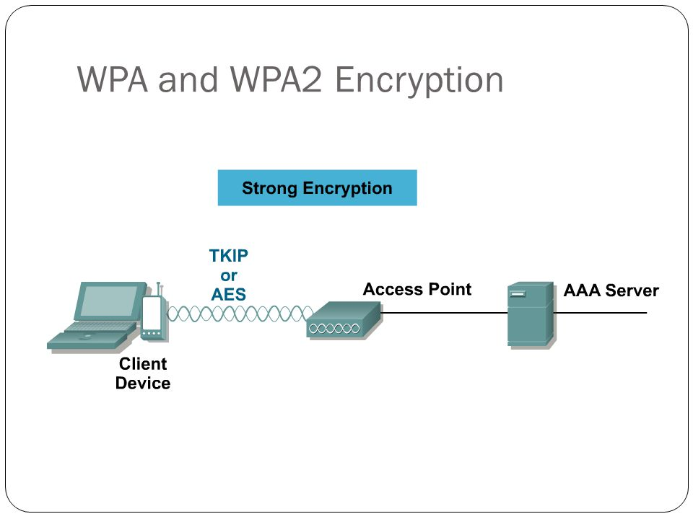
Cryptography
Security+
Session 6
Wireless Encryption
WEP (Wired Equivalent Privacy) – Original encryption method for wireless access points, that is considered insecure now.
WPA (WiFi Protected Access) – Uses the RC4 stream cipher with TKIP (Temporal Key Integrity Protocol) which mixes a root key with an initialization vector.
WPA2 (WiFi Protected Access 2) – Uses CCMP (Counter Mode with Cipher Block Chaining Protocol) which uses AES encryption.

Slide 32
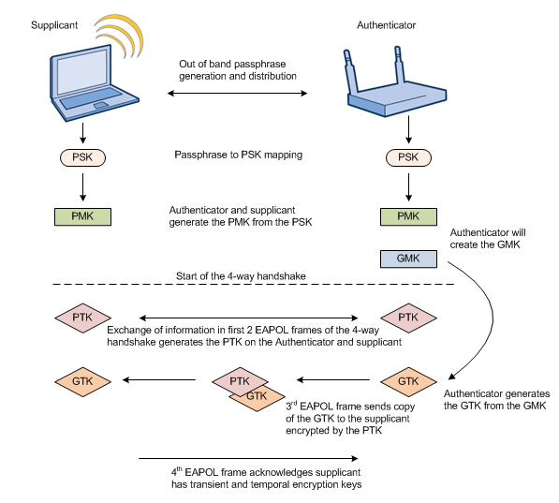
Cryptography
Security+
Session 6
Wireless Encryption
PSK (Pre-shared Key) – Mode of encryption where the client and wireless access point negotiate and share a key before beginning communication.
Enterprise – Mode of encryption where the server handles distribution of cryptographic keys.

Slide 33
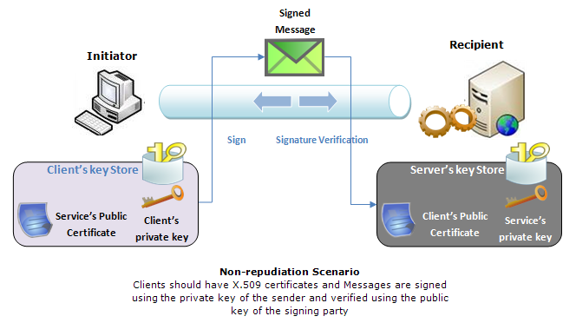
Cryptography
Security+
Session 6
Digital Signatures
Messages and documents can be signed with a digital signature, that validates the sender of the message.
Message is signed and sent using asymmetric cryptography, encrypted using the senders private key, and decrypted on the other end with the senders' public key.
A hash value of the message also validates that the message has not been changed in transit.
This process provides Non-repudiation, which verifies that the sender has sent the message and cannot deny it, because the user’s private key was used to sign the document.

Slide 34
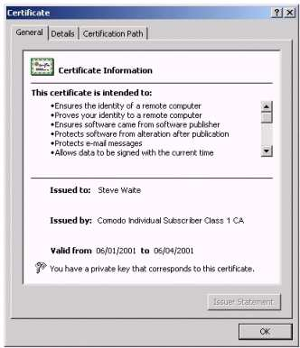
Cryptography
Security+
Session 6
PKI – Public Key Infrastructure
Based upon digital certificates formatted to the X.509 standard
Certificates contain:
Digital Signature algorithm
Public key information for asymmetric cryptography
Subject name and ID
Algorithms for doing hashing
Diffie-Hellman algorithm for key exchange
Expiration date
Digital signature of the issuer
All that is needed for secure identification and cryptographic message exchange.
Two types of certificates:
User certificates and Computer certificates

Slide 35
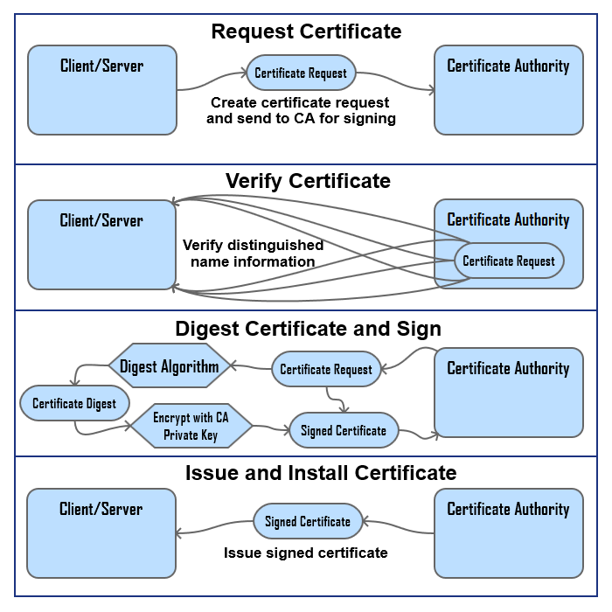
Cryptography
Security+
Session 6
PKI – Public Key Infrastructure
Certificates are obtained from a Certificate Authority.
An organization responsible for issuing, revoking, and distributing certificates.
Verisign
DigiCert
Thawte
A Registration Authority is an intermediary between the CA and the user to distribute keys, accept registration requests, and validate identities, etc.

Slide 36
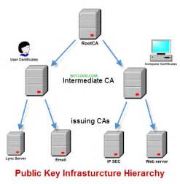
Cryptography
Security+
Session 6
PKI – Public Key Infrastructure

Slide 37
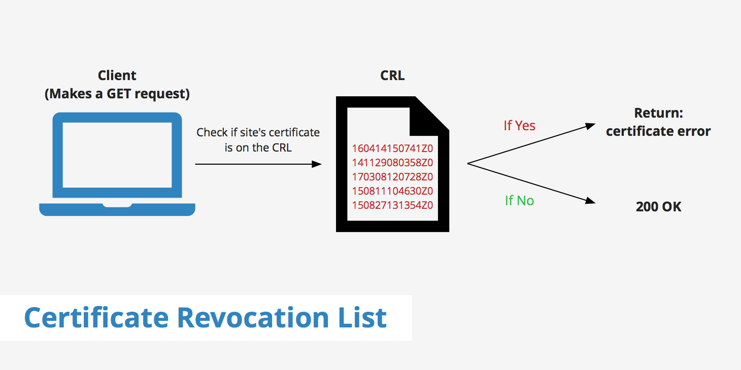
Cryptography
Security+
Session 6
PKI – Public Key Infrastructure
The CA maintains a Certificate Revocation List (CRL) online for all of their issued certificates. This list is checked each time that a certificate is used to see if it is still valid.
Another method of checking the validity of a certificate is through OCSP – Online Certificate Status Protocol that maintains a local network copy of the validity of certificates issued to its network.
Private keys are the center point for asymmetric encryption and may need to be escrowed for security. Key escrow provides a backup of the private keys. Key escrow is provided by the company that is using the encryption process.

Slide 38
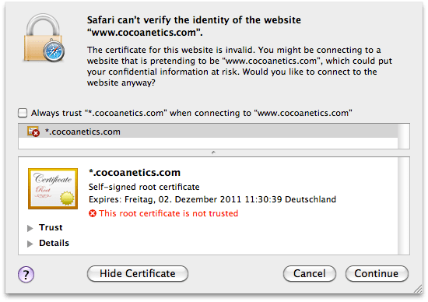
Cryptography
Security+
Session 6
PKI – Public Key Infrastructure
Types of certificates:
Wildcard certificates – one certificate for multiple domains.
Code signing certificates – used to digitally sign computer code.
Computer certificates – for machines to join a network and communicate within the network
Email certificates – for securing email traffic
User certificates – for user authentication and secure message traffic
Root certificates – used for root authorities
Self-signed certificates – you can create your own certificates. Saves the cost of buying a certificate, but without the security. If used for a website, then it is not a trusted certificate.

Slide 39
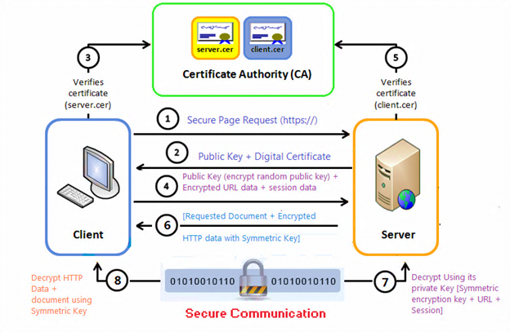
Cryptography
Security+
Session 6
Hybrid Cryptography – SSL
SSL (Secure Socket Layer) – used to establish a secure connection between two machines using the TCP protocol.
SSL establishes the session using asymmetric encryption and maintains the session with symmetric encryption.
Symmetric encryption is the faster of the two methods, and asymmetric is the slower.
This hybrid method uses a combination of encryption options, symmetric, asymmetric, hashing, message authentication, digital signatures.
SSL has evolved to TLS, but is still referred to as SSL

Slide 40
Cryptography
Security+
Session 6
Knowledge Check 4
A security analyst is hardening a server with the directory services role installed.
The analyst must ensure LDAP traffic cannot be monitored or sniffed and maintains compatibility with LDAP clients.
Which of the following should the analyst implement to meet these requirements?
(Select two.)
A. Generate an X.509-compliant certificate that is signed by a trusted CA.
B. Install and configure an SSH tunnel on the LDAP server.
C. Ensure port 389 is open between the clients and the servers using the communication.
D. Ensure port 636 is open between the clients and the servers using the communication.
E. Remote the LDAP directory service role from the server.

Slide 41
Cryptography
Security+
Session 6
Thank You!!
Send questions and slide deck requests to:
Jim Reeves
Security+, CASP+,CySA+, CISSP, ITILv3, CTT+
MCSE, MCSD, MCT
jireeves@Deloitte.com

